Slide 1
ASSET PRICING
Presented by Hoang Ngan

Slide 2
Agenda
Dataset
Experiments

Slide 3
dataSET
Historical prices: Yahoo!Finance
Tickers, ratios: Nasdaq
Sentiment: The Daily News Sentiment Index
Rates, spreads, other macros: FRED (Federal Reserve Economic Data)
Risk free rate: Fama-French Data Library

Slide 4
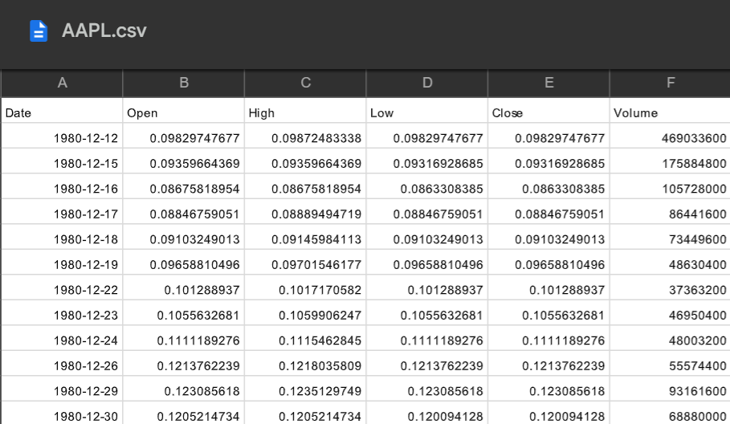
dataSET
Historical prices: Yahoo!Finance

Slide 5
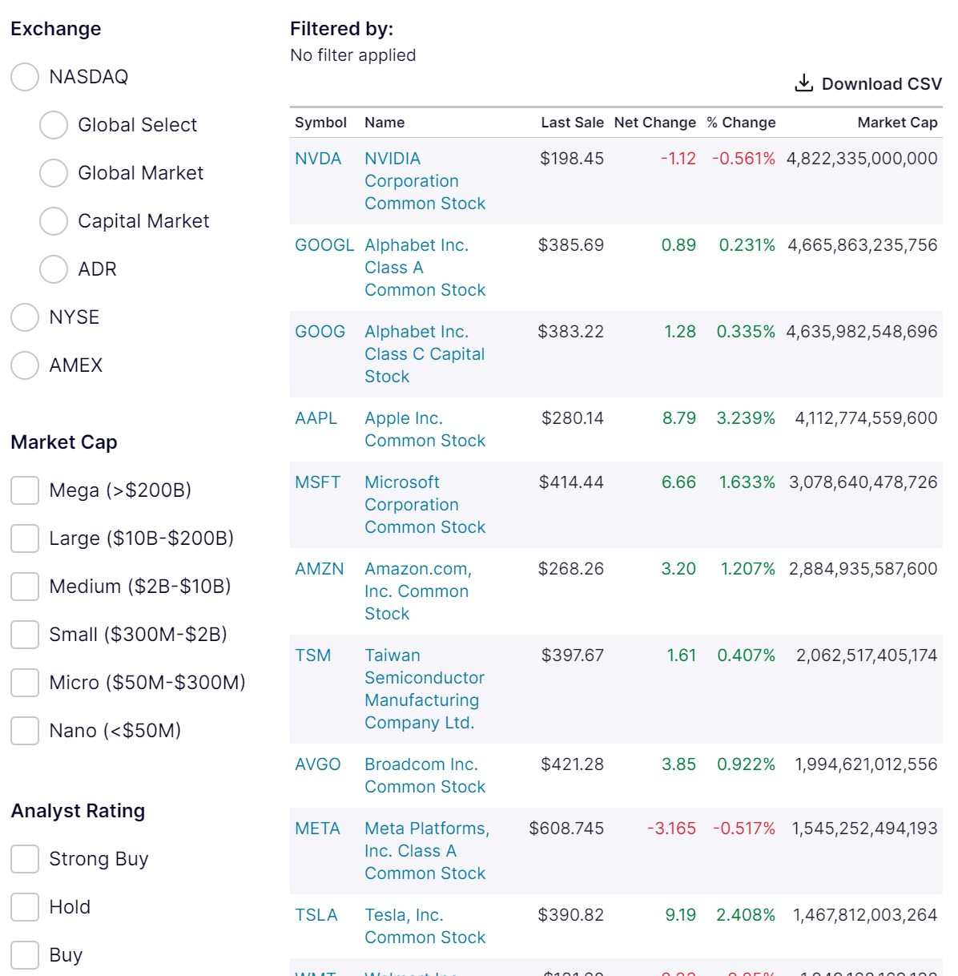
dataSET
Tickers, ratios: Nasdaq

Slide 6
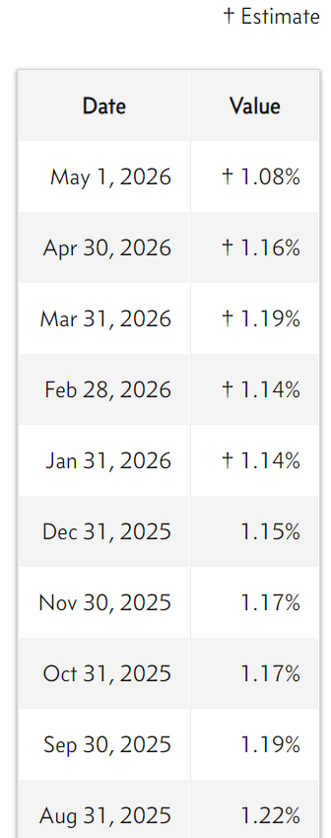
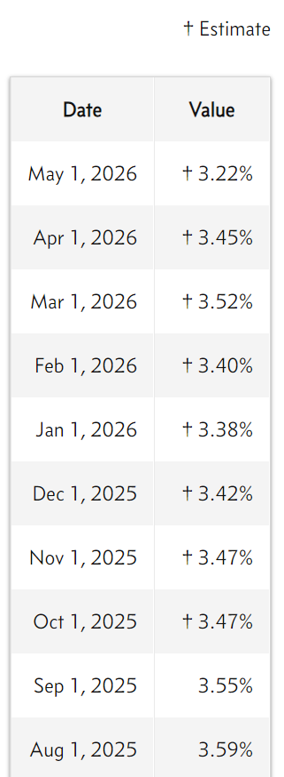
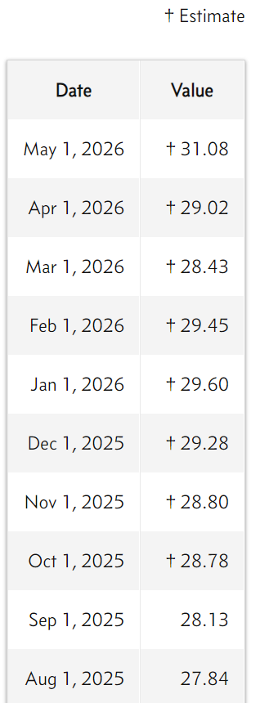
dataSET
Tickers, ratios: Nasdaq
S&P 500 Dividend Yield by Month
S&P 500 Earnings Yield by Month
S&P 500 PE Ratio by month

Slide 7
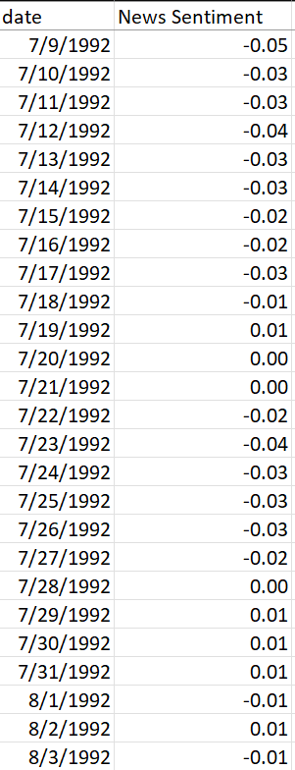
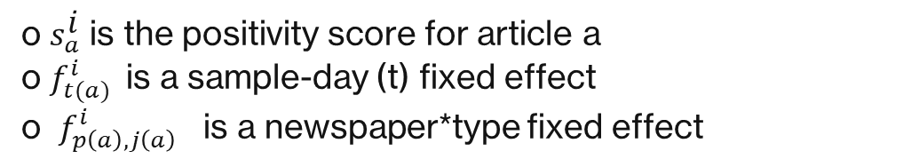
dataSET
Sentiment: The Daily News Sentiment Index
$$s_{a}^{i}=f_{t(a)}^{i}+f_{p\left(a\right), j\left(a\right)}^{i}+ε_{a}^{i}$$
o $s_{a}^{i}$ is the positivity score for article a
o $f_{t(a)}^{i}$is a sample-day (t) fixed effect
o $f_{p\left(a\right), j\left(a\right)}^{i}$ is a newspaper*type fixed effect

Slide 8
dataSET
Rates, spreads, other macros: FRED (Federal Reserve Economic Data)
T10Y2Y: The difference between the 10-year and 2-year Treasury yields (yield curve spread)
DTB3: 3-month Treasury bill interest rate
DTB6: 6-month Treasury bill interest rate
DPRIME: Prime rate (benchmark lending rate used by banks)
DFF: Federal Funds Rate (the central policy interest rate set by the Federal Reserve)

Slide 9
dataSET
Risk free rate: Fama-French Data Library
F-F_Research_Data_Factors:
Mkt-RF: risk-free
SMB: Small minus Big (size factor)
HML: High minus Low (value factor)
RF: Risk-free rate
Macro variables: CPIAUCSL: Consumer Price Index (CPI – chỉ số giá tiêu dùng); UNRATE: Unemployment Rate (tỷ lệ thất nghiệp)

Slide 10
dataSET
Features ~ 40
Momentum features
Volume features
Volatility features
Trend features
Beta

Slide 11
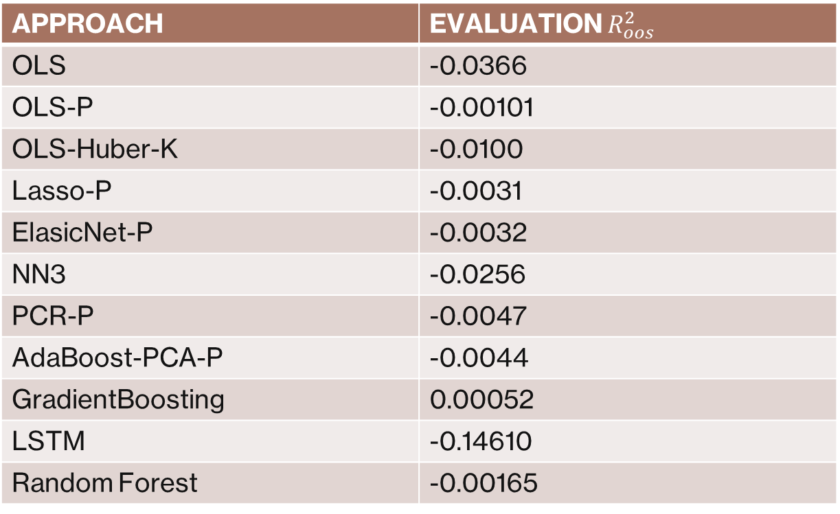
Experiments
APPROACH | EVALUATION $R_{oos}^{2}$
OLS | -0.0366
OLS-P | -0.00101
OLS-Huber-K | -0.0100
Lasso-P | -0.0031
ElasicNet-P | -0.0032
NN3 | -0.0256
PCR-P | -0.0047
AdaBoost-PCA-P | -0.0044
GradientBoosting | 0.00052
LSTM | -0.14610
Random Forest | -0.00165

